Slide 1
P A S S W O R D
A U T H E N T I C A T E D
K E Y
E X C H A N G E
B Y
J U G G L I N G

Slide 2
PREPARED AND PRESENTED BY STUDENTS OF
M.Sc. Computer and Information Science 4th Semester of University of Science and Technology College, University of Calcutta
HIRAKJYOTI BANEERJEE
DIPENDU GHOSH
Under the Supervision of:
Roll No. – 91-CIS-091012
Registration No – 0007312 of 2006-2007
Roll No. – 91-CIS-091007
Registration No – 0000439 of 2006-2007
Prof. DEVADATTA SINHA

Slide 3
Introduction

Slide 4
Introduction
Keys exchange protocols are cryptographic primitives used to provide a pair of users communicating over a public unreliable channel with a secure session key.
The username/password paradigm is the most commonly used authentication mechanism in security applications.
However passwords are low-entropy secrets, and subject to dictionary attacks. Hence, they must be protected during transmission.
The widely deployed method is to send passwords through SSL/TLS. But, this requires a Public Key Infrastructure (PKI) in place; maintaining a PKI is expensive. In addition, using SSL/TLS is subject to man-in-the-middle attacks.
Password-Authenticated Key Exchange (PAKE) studies how to establish secure communication between two remote parties solely based on their shared password, without requiring a Public Key Infrastructure (PKI).

Slide 5
Password authenticated key exchange (PAKE)
Two forms of PAKE are Balanced and Augmented methods.
Balanced PAKE allows parties that use the same password to negotiate and authenticate a shared key.
Augmented PAKE is a variation applicable to client/server scenarios, in which an attacker must perform a successful brute-force attack in order to masquerade as the client using stolen server data.
Examples of Balanced PAKE
Encrypted Key Exchange(EKE)
PAK and PPK
SPEKE (Simple password exponential key exchange)
J-PAKE (Password Authenticated Key Exchange by Juggling)
Examples of Augmented PAKE
AMP
Augmented-EKE
B-SPEKE
PAK-Z
SRP

Slide 6
DIFFIE- HELLMAN KEY
EXCHANGE

Slide 7
DIFFIE- HELLMAN KEY EXCHANGE
The first published public-key algorithm appeared in the seminal paper by Diffie and Hellman that defined public-key cryptography and is generally referred to as Diffie-Hellman Key Exchange.
The Diffie-Hellman algorithm depends for its effectiveness on the difficulty of computing discrete logarithms.
The purpose of this algorithm is to enable two users to securely exchange a key that can be used for subsequent encryption of messages.

Slide 8
DIFFIE- HELLMAN KEY EXCHANGE (contd.)
First we define a primitive root of a prime number p as one whose power modulo p generates all integers from 1 to p-1.
If a is a primitive root of a prime number p then the numbers
a mod p, a² mod p,……, a^{p-1} mod p
are distinct and consists of integers 1 through p-1 in some permutation.
For any integer b and a prime root a of prime number p, we can find a unique exponent i such that
b = a^{i} mod p where 0 ≤ i ≤ (p-1)
The exponent i is referred to as the discrete logarithm of b for the base a, mod p.
Diffie–Hellman establishes a shared secret that can be used for secret communications by exchanging data over a public network.

Slide 9
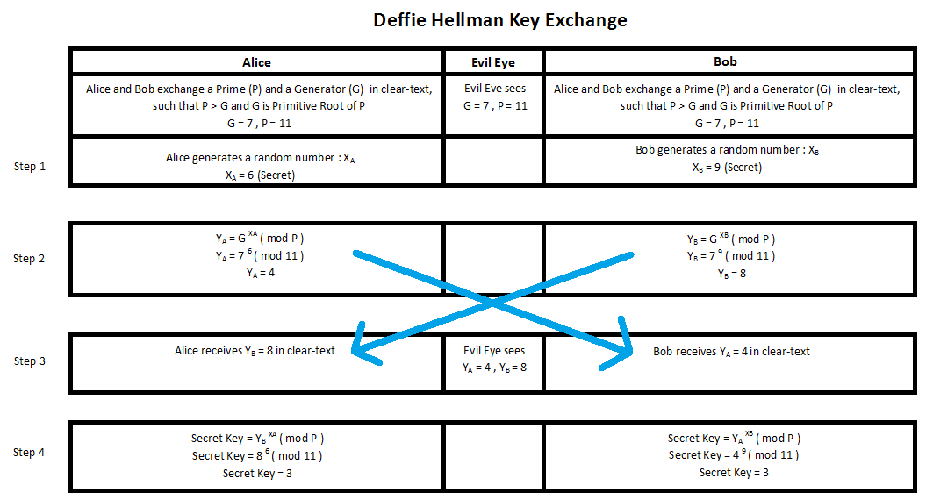
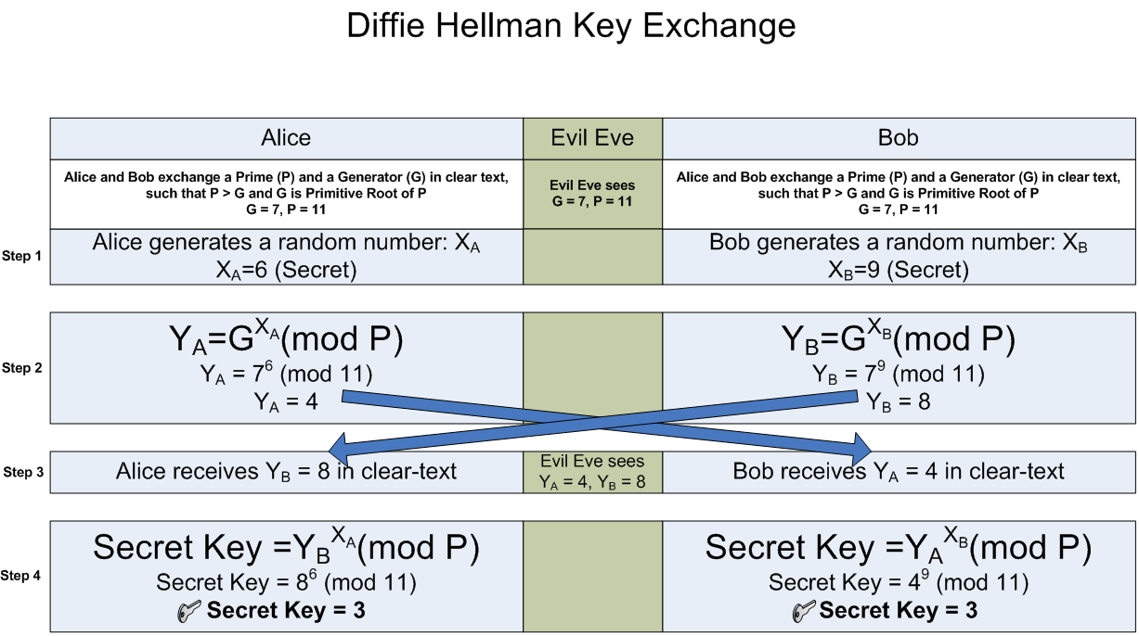
DIFFIE- HELLMAN KEY EXCHANGE (contd.) Description

Slide 10
DIFFIE- HELLMAN KEY EXCHANGE (contd.) Algorithm
Two publicly known numbers:
a prime number p
an integer g that is a primitive root of p
Step 1: User A selects a random integer X_{A} < p and User B selects a random integer X_{B} < p
Step 2: User A computes Y_{A} = g ^{XA} mod p and User B computes Y_{B} = g ^{XB} mod p
Step 3: Each side keeps the X values private and makes Y value available publicly to the other side
Step 4: User A computes K = (Y_{B}) ^{XA} mod p and User B computes K = (Y_{A}) ^{XB} mod p. These two calculations produce the same results

Slide 11
DIFFIE- HELLMAN KEY EXCHANGE (contd.) Man-in-the-Middle Attack
The Diffie-Hellman algorithm is insecure against the man-in-the-middle attack.
The attack proceeds as follows:
User X prepares for attack by generating two random private keys c and d and compute corresponding public keys X_{C} = g^{c} mod p and X_{D} = g^{d} mod p.
User A transmits A to User B.
User X intercepts A and transmits X_{C} to User B. User X then also calculates S_{A} = (A)^{d} mod p.
User B receives X_{C} and calculates S_{B} = (X_{C})^{b} mod p.
User B transmits B to User A.
User X intercepts B and transmits X_{D} to User A. User X then also calculates S_{B} = (B)^{c} mod p.
User A receives X_{D} and calculates S_{A} = (X_{D})ª mod p.
At this point User B and User A think that they share a secret key, but instead User B and User X share key S_{B} and User A and User X share secret key S_{A.} Thus if User X wants then he can eavesdrop the conversation without altering it or he can modify the message going from User A to User B and vice versa.

Slide 12
MODEL OF THE NETWORK FOR KEY EXCHANGE
We assume the key exchange is carried out over an unsecured network.
The security requirements that a PAKE protocol should fulfill.
Off-line dictionary attack resistance
Forward secrecy
Known-key
On-line dictionary attack resistance

Slide 13
PASSWORD
AUTHETICATED
KEY
EXCHANGE
BY JUGGLING

Slide 14
PASSWORD AUTHETICATED KEY EXCHANGE BY JUGGLING
In cryptography, the Password Authenticated Key Exchange by Juggling (or J-PAKE) is a password-authenticated key agreement protocol.
Password-authenticated key agreement generally encompasses methods such as:
Balanced password-authenticated key exchange
J-PAKE achieves the mutual authentication in two steps
Two parties send ephemeral public keys to each other
Augmented password-authenticated key exchange
Password-authenticated key retrieval
Multi-server methods
Multi-party methods
They encrypt the shared password by juggling the public keys in a verifiable way

Slide 15
PASSWORD AUTHETICATED KEY EXCHANGE BY JUGGLING
(contd.) Algorithm
Alice selects two secret values x₁ and x₂ at random : x₁ ЄR Z_{q} and x₂ ЄR Z_{q}*.
Bob selects two secret values x₃ and x₄ at random : x₃ ЄR Z_{q} and x₄ ЄR Z_{q}*.
q is prime.
Step 1: Alice sends out g^{x1}, g^{x2} and knowledge proofs for x1 and x2.
Similarly, Bob sends out g^{x3}, g^{x4} and knowledge proofs for x3 and x4.
When this step finishes, Alice and Bob verify the received knowledge proofs, and also check g^{x2}, g^{x4} ≠ 1.
Step 2: Alice sends out A = g^{(x1+x3+x4).x2.s} and a knowledge proof for x2.s. Similarly, Bob sends out B =g^{(x1+x2+x3).x4.s} and a knowledge proof for x4.s.
When this step finishes, Alice computes K = (B/g^{x2.x4.s})^{x2} = g^{(x1+x3).x2.x4.s}, and Bob computes K = (A/g^{x2.x4.s})^{x4} = g^{(x1+x3).x2.x4.s}.

Slide 16
PASSWORD AUTHETICATED KEY EXCHANGE BY JUGGLING
(contd.) Algorithm
Schnorr protocol:-
The knowledge proofs mentioned in the algorithm of J-PAKE are done in this way. The protocol is defined for a cyclic group G_{q} of order q with generator g.
In order to prove knowledge of x = log_{g}y, the prover interacts with the verifier as follows:
In the first round the prover commits herself to randomness r; therefore the first message t = g^{r} is also called commitment.
The verifier replies with a challenge c chosen at random.
After receiving c, the prover sends the third and last message (the response) s = r + cx.
The verifier accepts, if g^{s} = ty^{c}.

Slide 17
Implementation

Slide 18
DIFFIE- HELLMAN KEY EXCHANGE
Suppose Alice representing ‘user A’ and Bob representing ‘user B’ and they wants to interact among each other.
Also, suppose that in the case of ‘Man-In-The-Middle Attack’ an attacker is present..
Three main functions are used:-
user_a():
attacker():
Enters private key ‘a’
Generates public key ‘A’ and sends to the other user
Computes common private key ‘S_{A}’ from ‘B’ received
user_b():
Enters private key ‘b’
Generates public key ‘B’ and sends to the other user
Computes common private key ‘S_{B}’ from ‘A’ received
poses as user A to user B and as user B to user A

Slide 19
PASSWORD AUTHETICATED KEY EXCHANGE BY JUGGLING
Suppose user Alice and Bob wants to interact among each other.
The functions used here are described as:-
genrand():
genknp(&user) :
Generates the shared key ‘Secret’ and both users keep them using.
Selects secret values x₁ and x₂ for Alice
Selects secret values x₃ and x₄ for Bob
Where x₁,x₃ Є_{R} Z_{q} and x₂,x₄ Є_{R} Z*_{q} and x₂,x₄ ≠ 0.

Slide 20
PASSWORD AUTHETICATED KEY EXCHANGE BY JUGGLING (contd.)
sendstep1 (&from, &to, &param) :
verifysendstep1 (&from, &to, &param) :
sendstep2 (&from, &to, &param):
Alice sends g^{x1}, g^{x2} and knowledge proofs for x₁ and x₂.
Bob sends g^{x3}, g^{x4} and knowledge proofs for x₃ and x₄.
Verifies the received knowledge proofs, and also checks g^{x2} , g^{x4} ≠ 1 , for Alice and Bob.
verifysendstep2 (&from, &to, &param):
Alice sends A=g^{(x1+x3+x4)*x2*secret} and knowledge proof x₂*secret.
Bob sends B=g^{(x1+x2+x3)*x4*secret} and knowledge proof for x₄*secret.
Verifies the received knowledge proofs the received knowledge proofs of Alice and Bob.

Slide 21
PASSWORD AUTHETICATED KEY EXCHANGE BY JUGGLING (contd.)
compute_key (&user, &param):
hashing (struct JPakeUser *user):
Computes K=(B/g^{x2*x4*secret})^{x2}= g^{(x1+x3)*x2*x4·secret} for Alice
Computes K=(A/g^{x2*x4*secret})^{x4}= g^{(x1+x3)*x2*x4·secret} for Bob.
Performs hashing on the computed keys for the users and maps them in the hash table.

Slide 22
PASSWORD AUTHETICATED KEY EXCHANGE BY JUGGLING (contd.)
The Following three functions are requird to calculate the knowledge proofs and verifying the sent knowledge proofs:
zkp (from, to, param, step number):
prover (from, to, param, step number, variable order):
verifier(u, step number, variable order, generator,commitment,challenge,s,x) :
Invokes prover for calculating the knowlwdge proofs.
Invokes verifier for verifing the received knowlwdge proofs.
Generates a random number ‘r’ called the commitment and calculates t=g^{r}
Receives a random number ‘c’ called the challenge from verifier.
Sends s=r + c * x
Verifies the sent knowledge proofs by checking if g^{s} = t*y^{c}

Slide 23
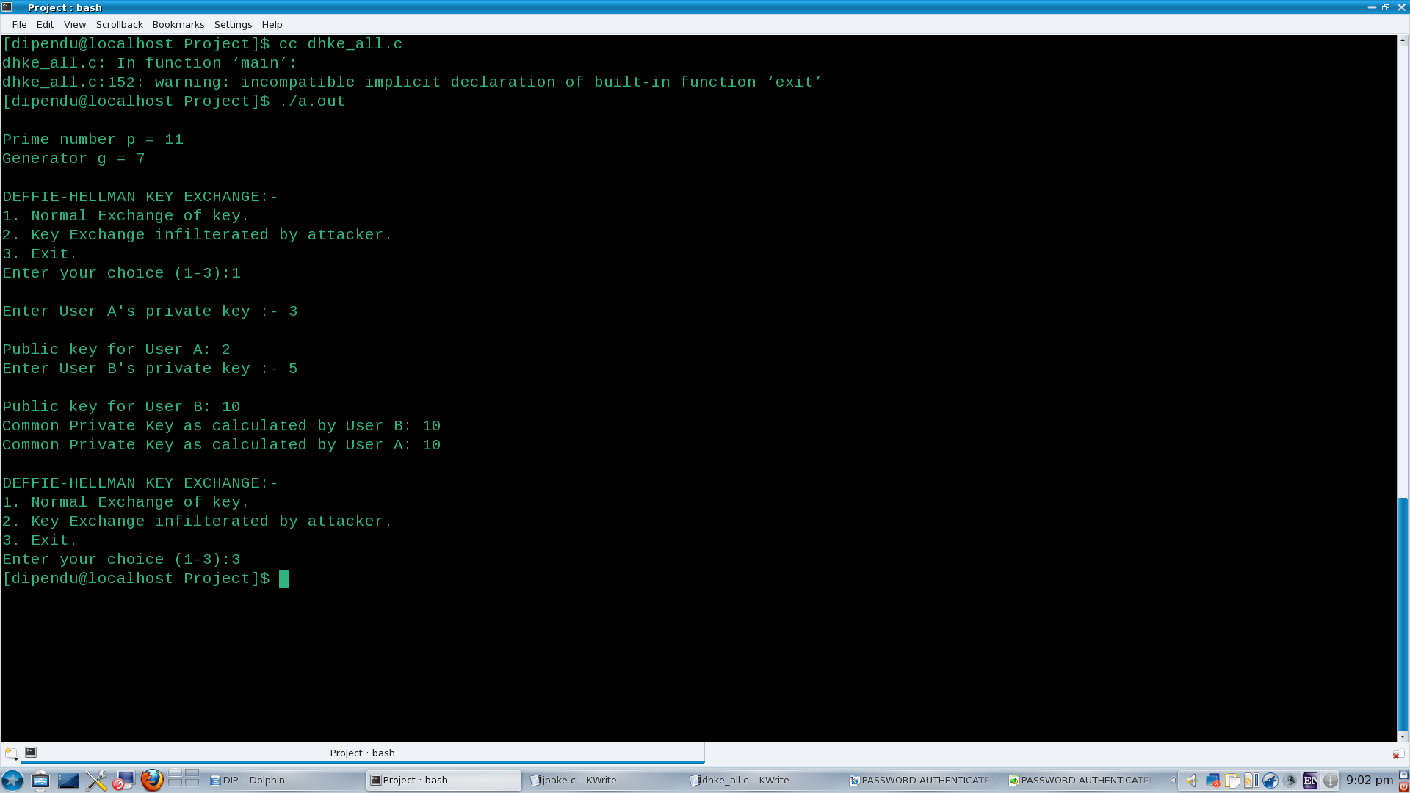
OUTPUTS

Slide 24
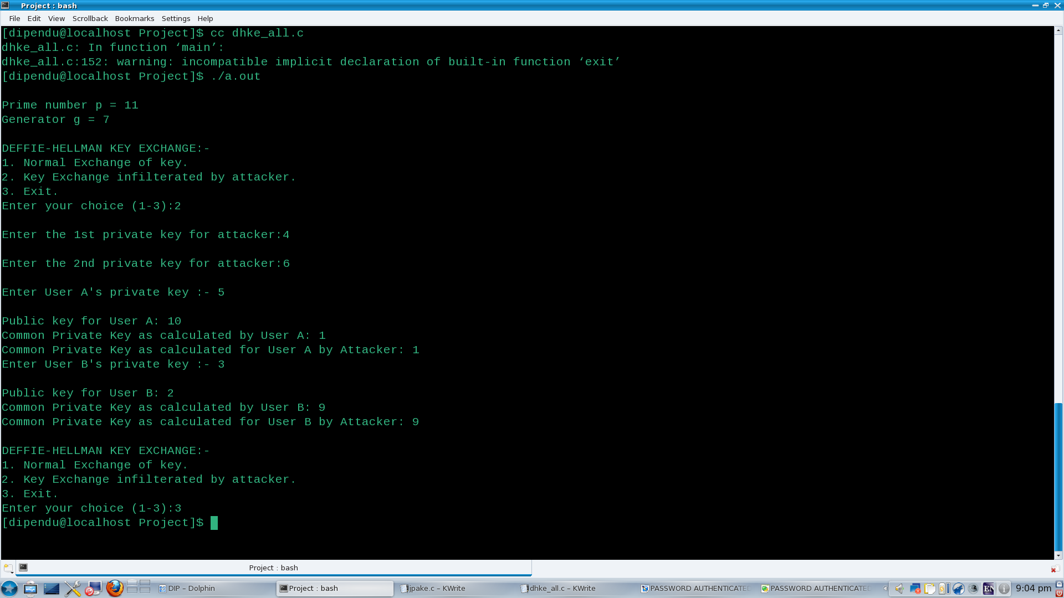
OUTPUTS

Slide 25
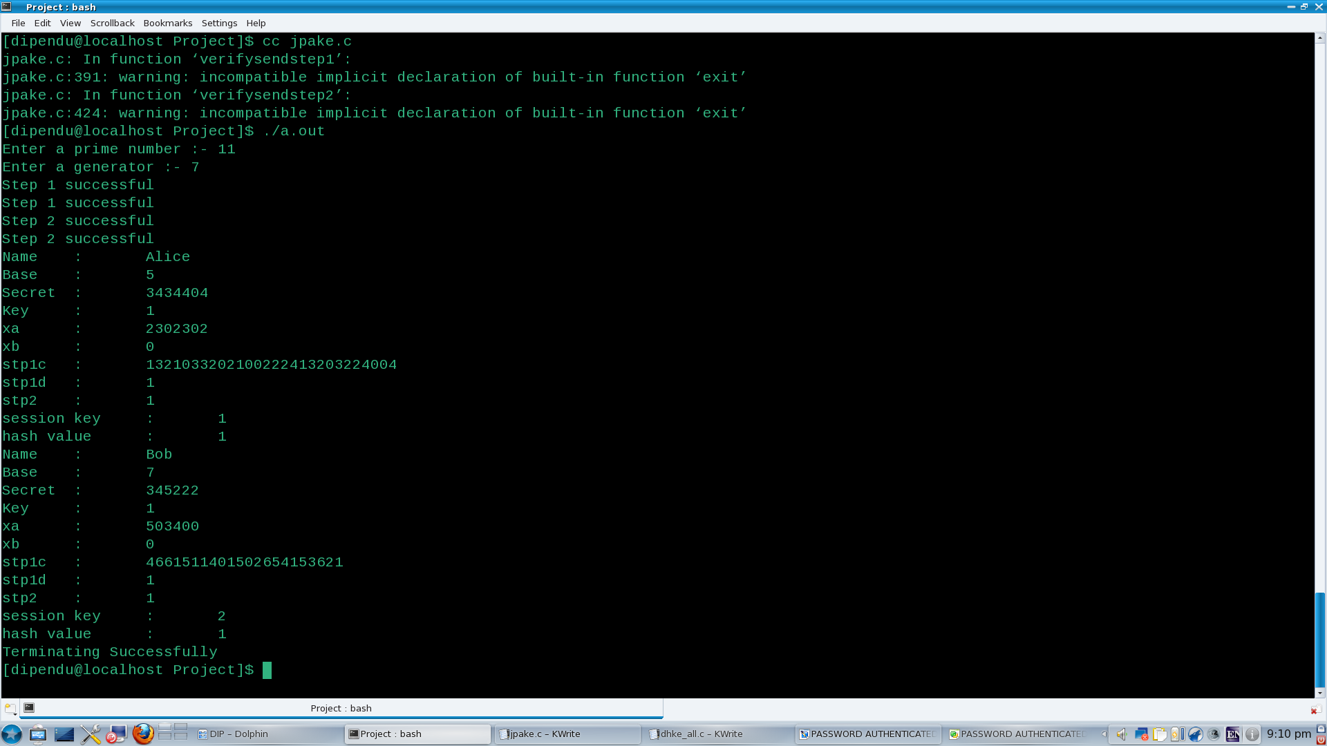
OUTPUTS

Slide 26
CONCLUSION
Here we have shown how the Diffie-Hellman Key Exchange Algorithm works and how it fails in the face of the man-in-the-middle attack.
We have also shown how J-PAKE algorithm works.
The implementation of J-PAKE in a simulated environment proves that it is effective as a PAKE technique and can be implemented in real life to overcome that shortcomings of DHKE.
As compared to the de facto internet standard SSL/TLS, J-PAKE is more lightweight in password authentication with two notable advantages:
1. It requires no PKI deployments;
2. It protects users from leaking passwords (say to a fake bank website).

Slide 27
FUTURE SCOPE
Here we have programmed only a simulated environment. So we didn’t compute keys which have huge number of digits.
In future we need to implement password authenticated key exchange by juggling in a real-world networked environment.
We also need to show by implementing certain cases that a network with J-PAKE implemented on it is secure against an attacker.

Slide 28
REFERENCES
Simple Password-Based Encrypted Key Exchange Protocols
By Michel Abdalla and David Pointcheval
Password Authenticated Key Exchange by Juggling
By Feng Hao from Center for Computational Science, University College London
And Peter Ryan from School Of Computing Science, University of Newcastle upon Tyne
Cryptography and Network Security Principles and Practices, 4th Ed
By William Stallings
http://en.wikipedia.org/wiki/Schnorr_signature
http://en.wikipedia.org/wiki/Diffie-Hellman_key_exchange
http://en.wikipedia.org/wiki/Schnorr_group
http://en.wikipedia.org/wiki/Cyclic_group
http://en.wikipedia.org/wiki/Proof_of_knowledge
http://en.wikipedia.org/wiki/PAKE
http://en.wikipedia.org/wiki/J-PAKE
http://www.lix.polytechnique.fr/~liberti/public/computing/prog/c/C/FUNCTIONS/rand.html
http://www.dreamincode.net/forums/topic/12660-use-of-rand-function/
http://pubs.opengroup.org/onlinepubs/009695399/functions/rand.html

Slide 29
ACKNOWLEDGEMENT
Our sincere thanks to :
Prof. Nabendu Chaki,
Library of Department of Computer Science and Engineering,
Prof. Devadatta Sinha (Project Guide),
Department of Computer Science and Engineering,
University College of Science and Technology ,
University of Calcutta
Chairman,
Board of Post Graduate Studies,
Department of Computer Science and Engineering, University College of Science and Technology,
University of Calcutta
University College of Science and Technology,
University of Calcutta

Slide 30
THANK YOU !

